Slide 1


Slide 2

PIT COUNT 101
What is the PIT Count?
- A literal count of all the people experiencing homelessness in our community on a single night (i.e., at a point in time).
- Conducted by every community nationwide in the last 10 days of January at least every other year.
- A "snapshot" of homelessness on this one night in our community.

Slide 3
PIT COUNT 101
Who is Counted in the PIT Count?
The U.S. Department of Housing and Urban Development's (HUD's) definition of homeless, for the purpose of the PIT count, includes two main types of homelessness:

Slide 4
PIT COUNT 101
Who is Counted in the PIT Count?
Unsheltered: Individuals or families whose primary night time residence is a public place not meant for human habitation
- Examples - Car, Park, Abandoned building, Bus station, Camping Ground
Sheltered: individuals or families residing in a place dedicated to serving people who would otherwise be unsheltered
- Examples Emergency Shelters, Transitional Housing

Slide 5
PIT COUNT 101
Why do we do a PIT Count?
- To measure and monitor trends and changes in homelessness on local and national levels
- To help our community understand what resources we need to strategize the best ways to use them to end homelessness
- To comply with federal regulations and requirements

Slide 6
YOUR ROLE
Surveying Tips
- Remember that you are speaking to highly vulnerable people and asking some very sensitive questions. Always lead with respect for the person you're speaking with and respect for their dignity.
- Everyone has the right to refuse to answer any or all of your questions.
- Ask all questions, unless the person has already given the answer to the question over the course of your conversation.

Slide 7
YOUR ROLE
Surveying Tips
- Always ask questions as they are written; do not ask questions in a way that shows you think you already know the answer.
Example: Ask "How do you identify your gender?"
Do NOT ask: "You're male, right?"

Slide 8
STEP BY STEP GUIDE
Step 1: Approach and Introduction
- Approach the person and introduce yourself
- Speak slowly, be polite, don't shout.
- Smile
Keep in mind: Individuals sleeping outside may be dealing with active addiction, mental health concerns, and significant trauma histories.

Slide 9
STEP BY STEP GUIDE
Step 1: Approach and Introduction
Don’t: Sneak up or corner someone, identify yourself immediately when approaching individuals

Slide 10
STEP BY STEP GUIDE
Step 2: Explain what you are doing and get consent.
- Explain why you're there
- Ask them if they have a couple of minutes to complete a survey
- If they consent to answering your questions, continue with the interview. If they don't thank them for their time and make observations on the form.
Let them know they will receive a gift bag for participating!

Slide 11
STEP BY STEP GUIDE
Step 2: Explain what you are doing and get consent.
Don’t: Hand the survey to the client to complete alone, go through it with them.
Don’t: Assume you know the answers to survey questions.

Slide 12
STEP BY STEP GUIDE
Step 3: Conduct the interview using the survey form.
- Go through each question in the survey form. Remember people have the right not to answer all questions!
- Add any notes that may be helpful.

Slide 13
STEP BY STEP GUIDE
Step 3: Conduct the interview using the survey form.
Don’t: Force people to answer questions if they don’t want to.

Slide 14
STEP BY STEP GUIDE
Step 4: Closing the interview.
- Thank the person for their time.
- Refer them to any services or resources that they may have asked about or may need.
- Give them a bag.

Slide 15
Who to Interview?
- It is not always possible to determine if someone experiencing homelessness based solely on how they look.
- Consider: Where do you see the person? What is the person doing? What time is it?
- Best practice: Approach everyone you see. You can use a soft, non-confrontational introduction that's easy to reverse course if the person is not experiencing homelessness.

Slide 16
YOUR SAFETY
- You should ALWAYS be with at least one other person.
- Keep an appropriate conversational distance from those you are interviewing.
- Maintain awareness of the space around you - where other people are, ways to get in or out of the space you're in, etc.
- Prioritize your own safety. If you don't feel safe approaching someone or going somewhere, don't go.
- Do not transport anyone other than volunteers in your personal vehicle.

Slide 17
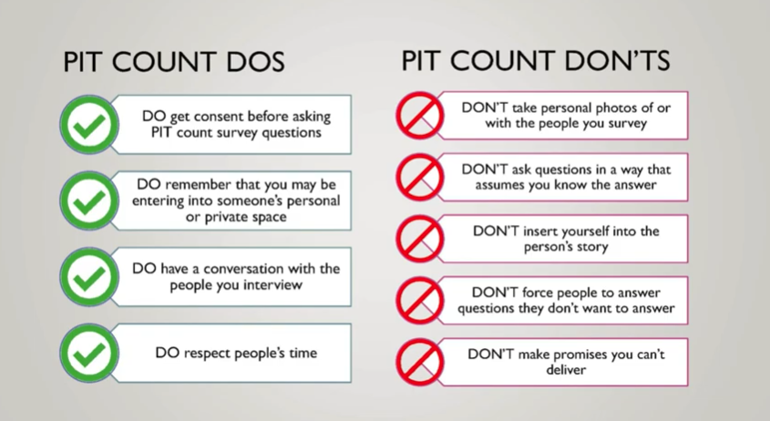
YOUR SAFETY

